Slide 1

The Heat Project – Energy Advice for SMEs
Part of BRDT, the Blairgowrie and Rattray Development Trust. We can support households and SMEs with energy efficiency and sustainability advice free of charge.

Slide 2

Contents
Energy use and bills
Funding
Lighting
Draught proofing
Insulation
Heating
Temperature control, heating and cooling
Refrigeration
Management and communication
You can get a 1 to 1 visit for us to help with the specifics of your business
Summary/key takeaways

Slide 3

Summary/key takeaways
Summarising some of the easy wins that have low risk and zero to low cost:
  LED lights
  Draught proofing
  Quick win insulation
  Heating controls
  1:1 support freely available
  Funding support for upgrades (including controls)
    75% grants, 0% loans from Business Energy Scotland
    50% grants from PKC (potentially able to combine)

Slide 4
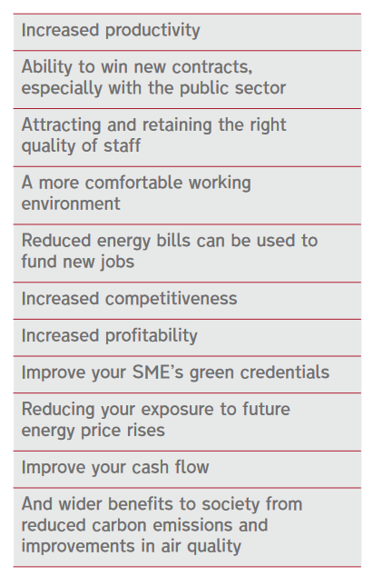
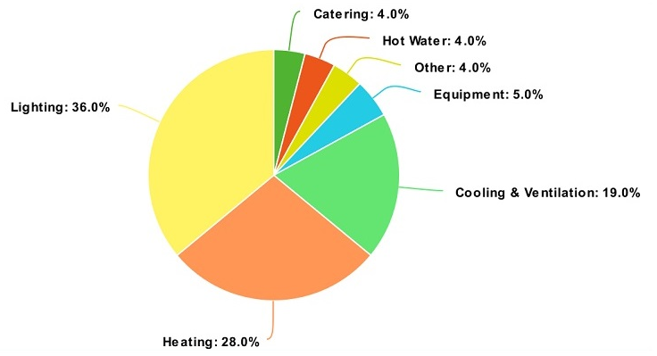
Energy use and bills
Average electricity prices more than doubled and gas prices nearly tripled since Aug 2021
Energy savings go straight to helping the bottom line and stay there year after year. How much profit would even small savings equate to?
Energy saving goes hand in hand with other benefits:
Lighting and heating are often the largest users of energy. Refrigeration as well if present.
Small shops often: heating > lighting
Notes:
Energy savings go straight to the bottom line and stay there year after year. Even if the return on some measures might feel small at first, if worth considering how many extra sales you’d need to make for the same amount of profit.

Slide 5


Funding
Business Energy Scotland – call on 0808 808 2268 https://businessenergyscotland.org/
Business Energy Scotland – Apply online at www.pkc.gov.uk/article/22502/Green-Recovery-Capital-Development-Grant. Any queries can contact BusinessDevelopment@pkc.gov.uk
Business Energy Scotland:
  Energy efficiency measures – 75% grant of eligible costs up to a maximum of £20,000
  Renewable heat measures – 75% grant of eligible costs up to a maximum of £10,000 (heat pumps, biomass boilers etc)
  Other renewables (solar panels) – 0% loan only
  Remaining costs for any of above – 0% loan (repayment over 8 years)
PKC Green Recovery Capital Development Grant:
  Energy efficiency and renewable measures – 50% grant of eligible costs up to a maximum of £25,000.
  Minimum threshold cost of £10,000 for project/upgrade (except electric vehicle charging point installation)
  Solar panels, replacement windows, electric vehicle charger – requires 5 year lease and be part of wider energy efficiency upgrade
  Might be possible to combine
  Available for leased properties
Notes:
Heating, ventilation and air conditioning
▪ Condensing, combination, modular and steam boilers
▪ Boiler - Burner replacement
▪ Boiler - Burner management
▪ Warm-air units
▪ Radiant heating units
▪ Combined heat and power (CHP) with gas
▪ Under-floor heating
▪ Air curtains
▪ Cooling system replacement/upgrade
▪ Heating and cooling controls
▪ Building management systems
▪ Heat recovery units
▪ High efficiency fans (destratification, ventilation system fans etc.)
▪ Commercial hot water systems
▪ Electric Storage Heaters
Building fabric
▪ Cavity wall insulation
▪ Loft insulation
▪ Flat roof insulation
▪ Internal wall insulation
▪ External wall insulation
▪ Draught proofing
▪ Floor insulation
▪ Heating system insulation (cylinder, pipes etc.)
▪ High performance external and internal doors
▪ High performance window coverings
▪ Double glazing
▪ Secondary glazing
Renewables
▪ Solar PV
▪ Wind turbine
▪ Micro-hydro system
▪ Solar Thermal
▪ Biomass boiler
▪ Biomass room heaters (with radiators)
▪ Air source heat pump
▪ Water source heat pump
▪ Ground source heat pump
▪ Combined heat and power with Biomass
▪ Anaerobic digestion
Other equipment
▪ Measuring, monitoring and control equipment
▪ Lighting systems, fitting and controls
▪ Voltage optimisation
▪ Variable speed drives
▪ Energy efficient motors and controls
▪ Air compressors
▪ Commercial cooking and baking equipment
▪ Commercial cleaning equipment e.g. washing machines, dryers, dishwashers
▪ Commercial fridge and freezer units
▪ Multi-glazed refrigeration doors/covers
▪ High efficiency hand dryers
▪ IT equipment
▪ Swimming pool covers

Slide 6
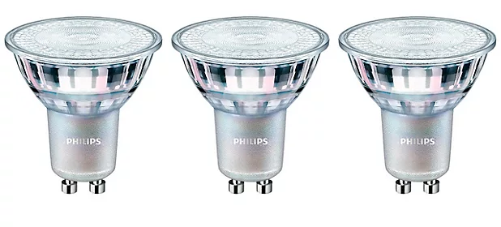
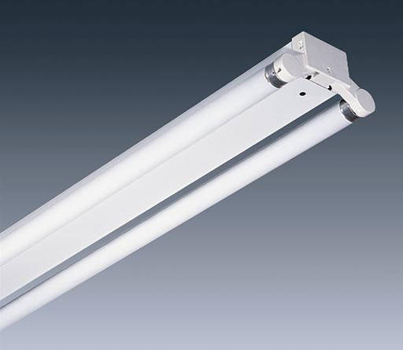
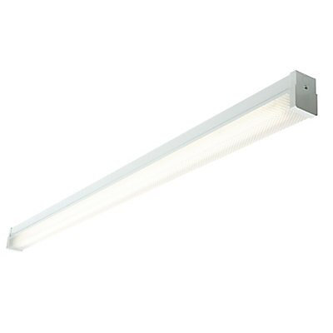
Lighting
55W 10W
LEDs use much less energy and have reduced in cost in recent years.
Lighting used for most of the day, every day, maybe very economical to replace with LEDs
Straight bulb swaps are possible and cheap to DIY, however for fluorescent tubes, you may want to consider professional rewiring to prolong the life of any new LED lighting. Either way will lead to savings.
Efficient use of controls can save money for no cost at all. Considering turning lights off overnight is a key example.
  Turning off two 5ft fluorescent tube lights that are left on overnight would save £92/year.
Even if your premises is rented, the short payback can be worth it.
58W 24W
Fluorescent 5ft T8 tube – 58W
LED 5ft tube – 24W
6 tubes, used 7 hours a day, 5 days a week, 33p/kWh:
Fluorescent = £200/year
LED = £80/year
Saving = £120/year
Payback DIY tubes, under 1 year
Professional rewire, 2-3 years or much less with 75% grant from BES.
Notes:
Fluorescent ballasts can fail, requiring continued maintenance and eventual replacement or bypass of the ballast; potential issues with fluorescent ballast compatibility; lower overall electrical efficiency due to ballast.

Slide 7
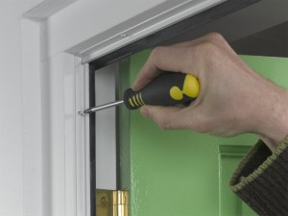
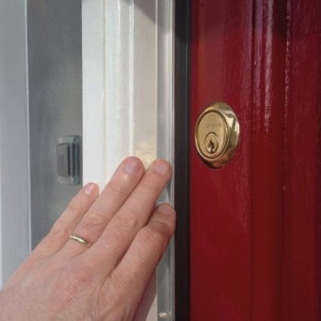
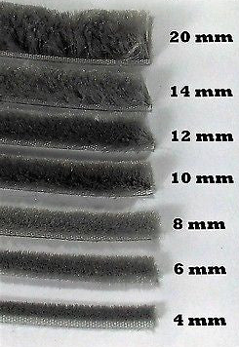
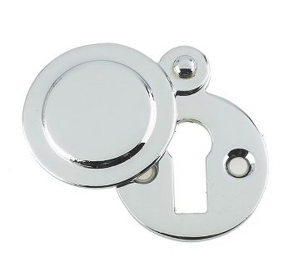
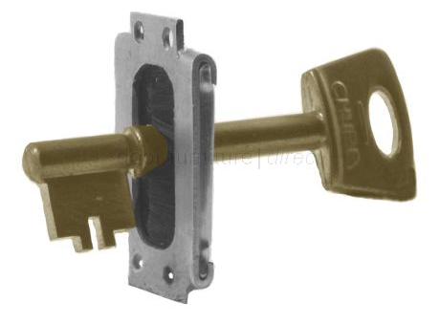
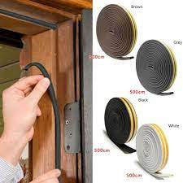
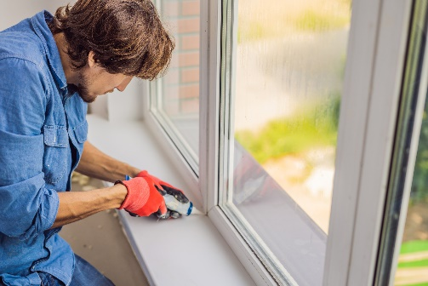
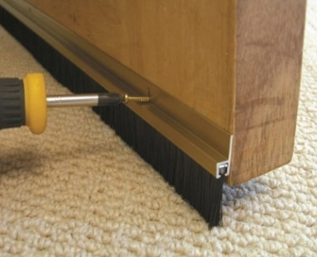
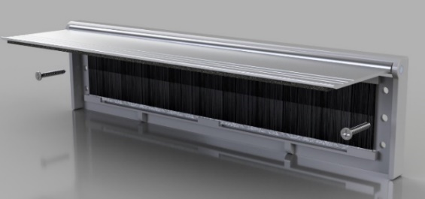
Draught proofing
Keep the cold out!
Up to or over 1/3 of your heat can be lost through draughts.
Draughts also make you feel colder due to air movements.
Major sources of draughts include;
            Door gaps
            Window gaps
Draught proofing can be done cheaply with DIY materials or professionally for a more thorough job.
Even if your premises is rented, the short payback can be worth it.
If of interest, The Heat Project can help with a draught survey to help identify areas of high heat loss from draughts.

Slide 8
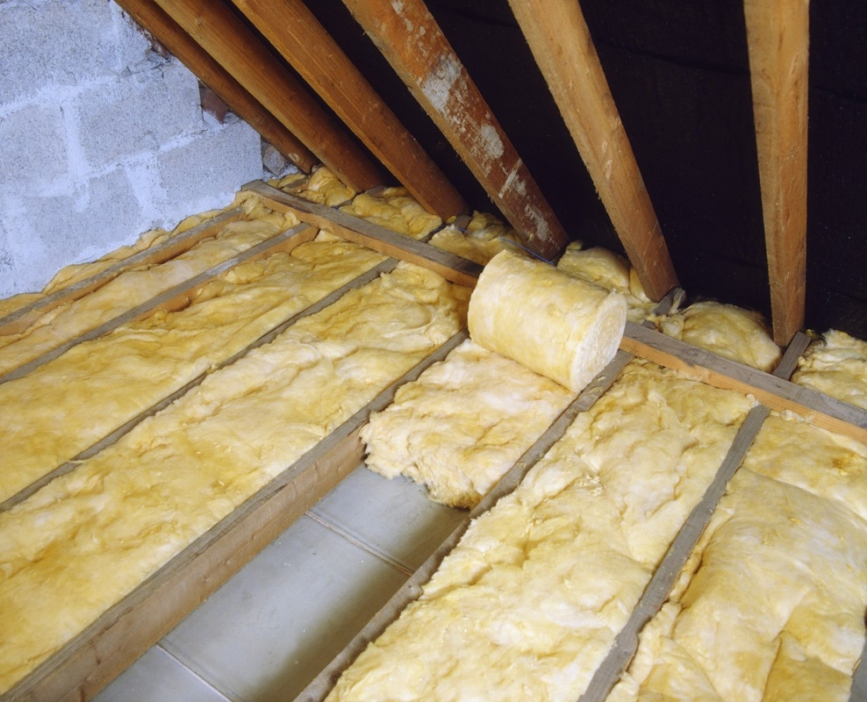
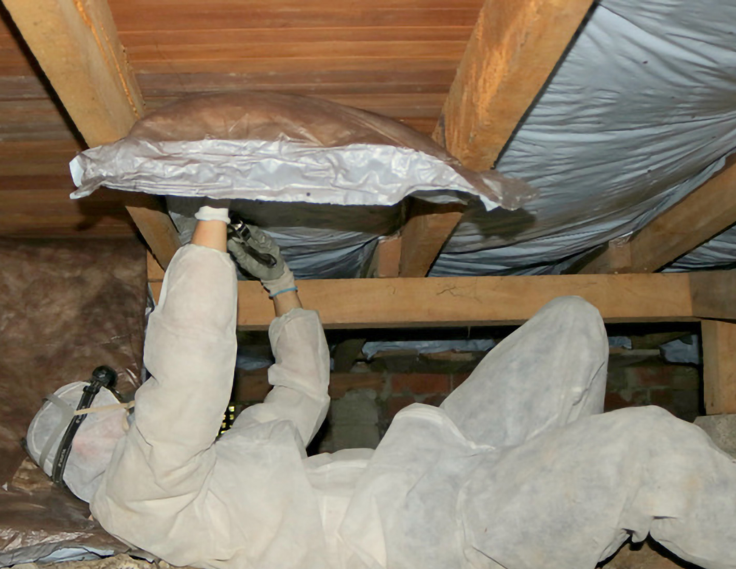
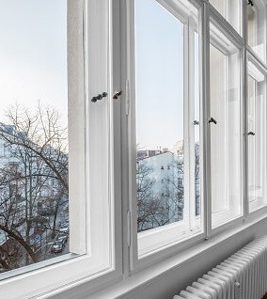
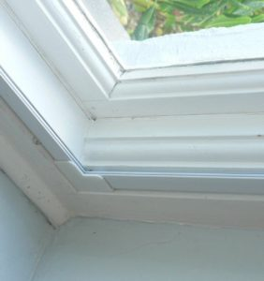
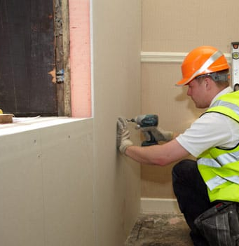

Insulation
With rented premises installing insulation may depend upon matching payback time to your expected tenancy. It also may require landlord permission.
However, certain measures may still be of interest such as;
  Loft insulation
  Secondary glazing (if windows take up a large area)
  Suspended floor insulation (if it is easy to access)
Wall insulation is a larger job, is more expensive, and will likely require redecorating. But can have big gains to show for it.
On top of our 1 to 1 advice, The Heat Project can help with thermal imaging to see areas of heat loss in winter or overheating in summer.

Slide 9
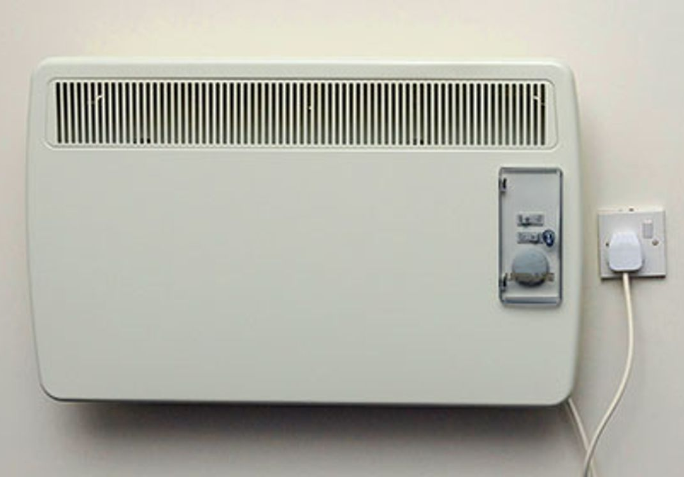
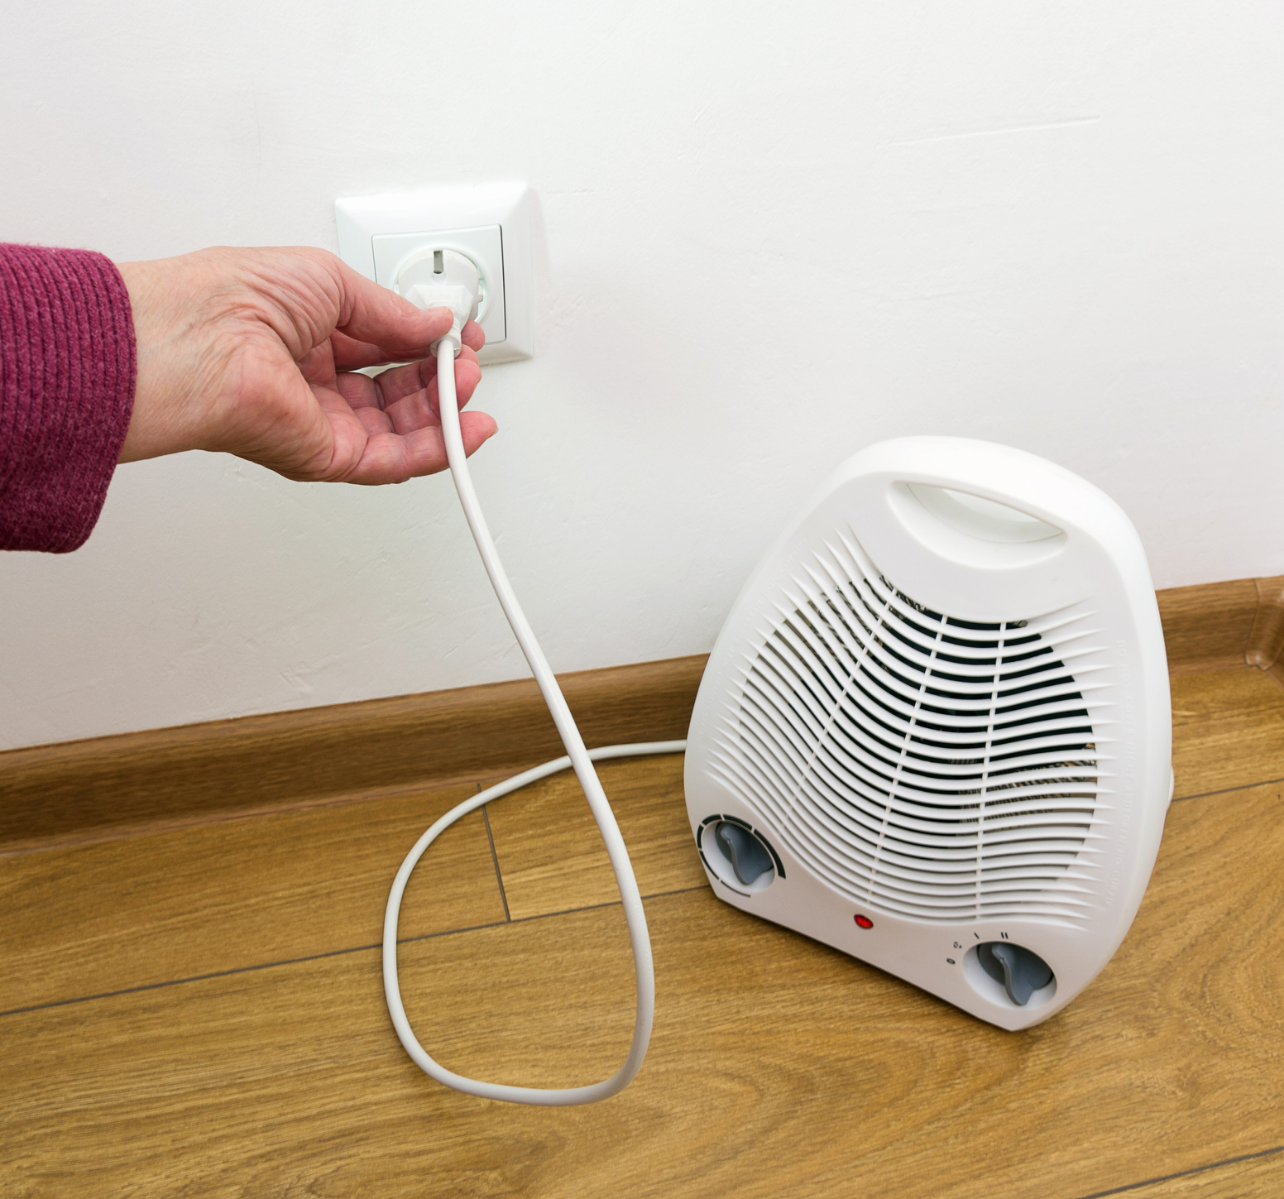

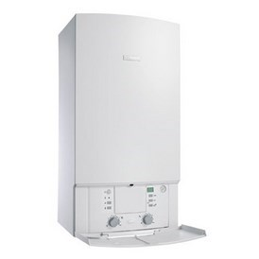
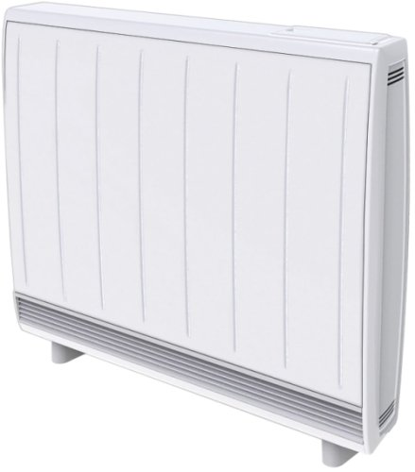
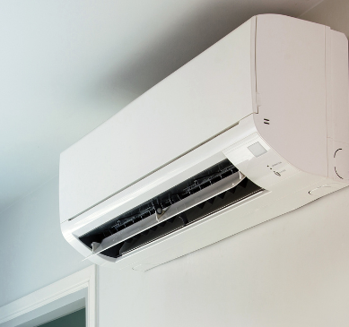
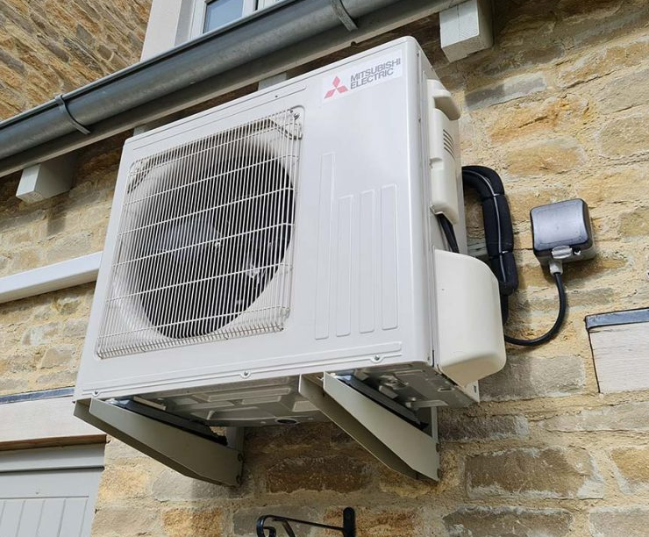
Heating
Grant funding of 75% up to £10,000 or £20,000 available
If you have electric heating, as you probably already know, it is likely your largest energy cost.
Using controls is key for any type of heating (next slide).
If on gas with an old boiler it may be worth upgrading to condensing.
If on electric heating, and if some non-financial hurdles are not too big, then an air-to-air heat pump could save 1/3 on heating costs. £1,500-£3,000 cost but eligible for the 75% grant. Payback could be less than 2-3 years with the grant.
High heat retention storage heaters are also an option for replacing expensive electric heating, savings up to 1/2 on heating costs. £800-£1000 cost per radiator but also eligible for the 75% grant. Payback could be less than 2-3 years with the grant.
If you are really struggling with high heating costs, try to heat the person, especially if sitting in a cold shop all day. Hot water bottles, blanket, keep feet warm, stay away from large windows and draughts (and fix draughts).
On top of our 1 to 1 advice, The Heat Project can help calculate estimated cost savings and payback times for any measures.

Slide 10
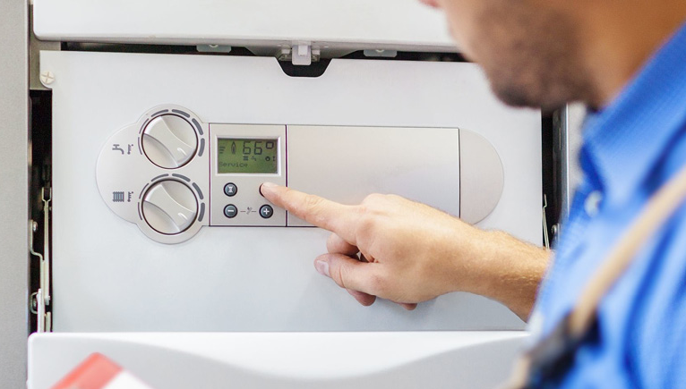
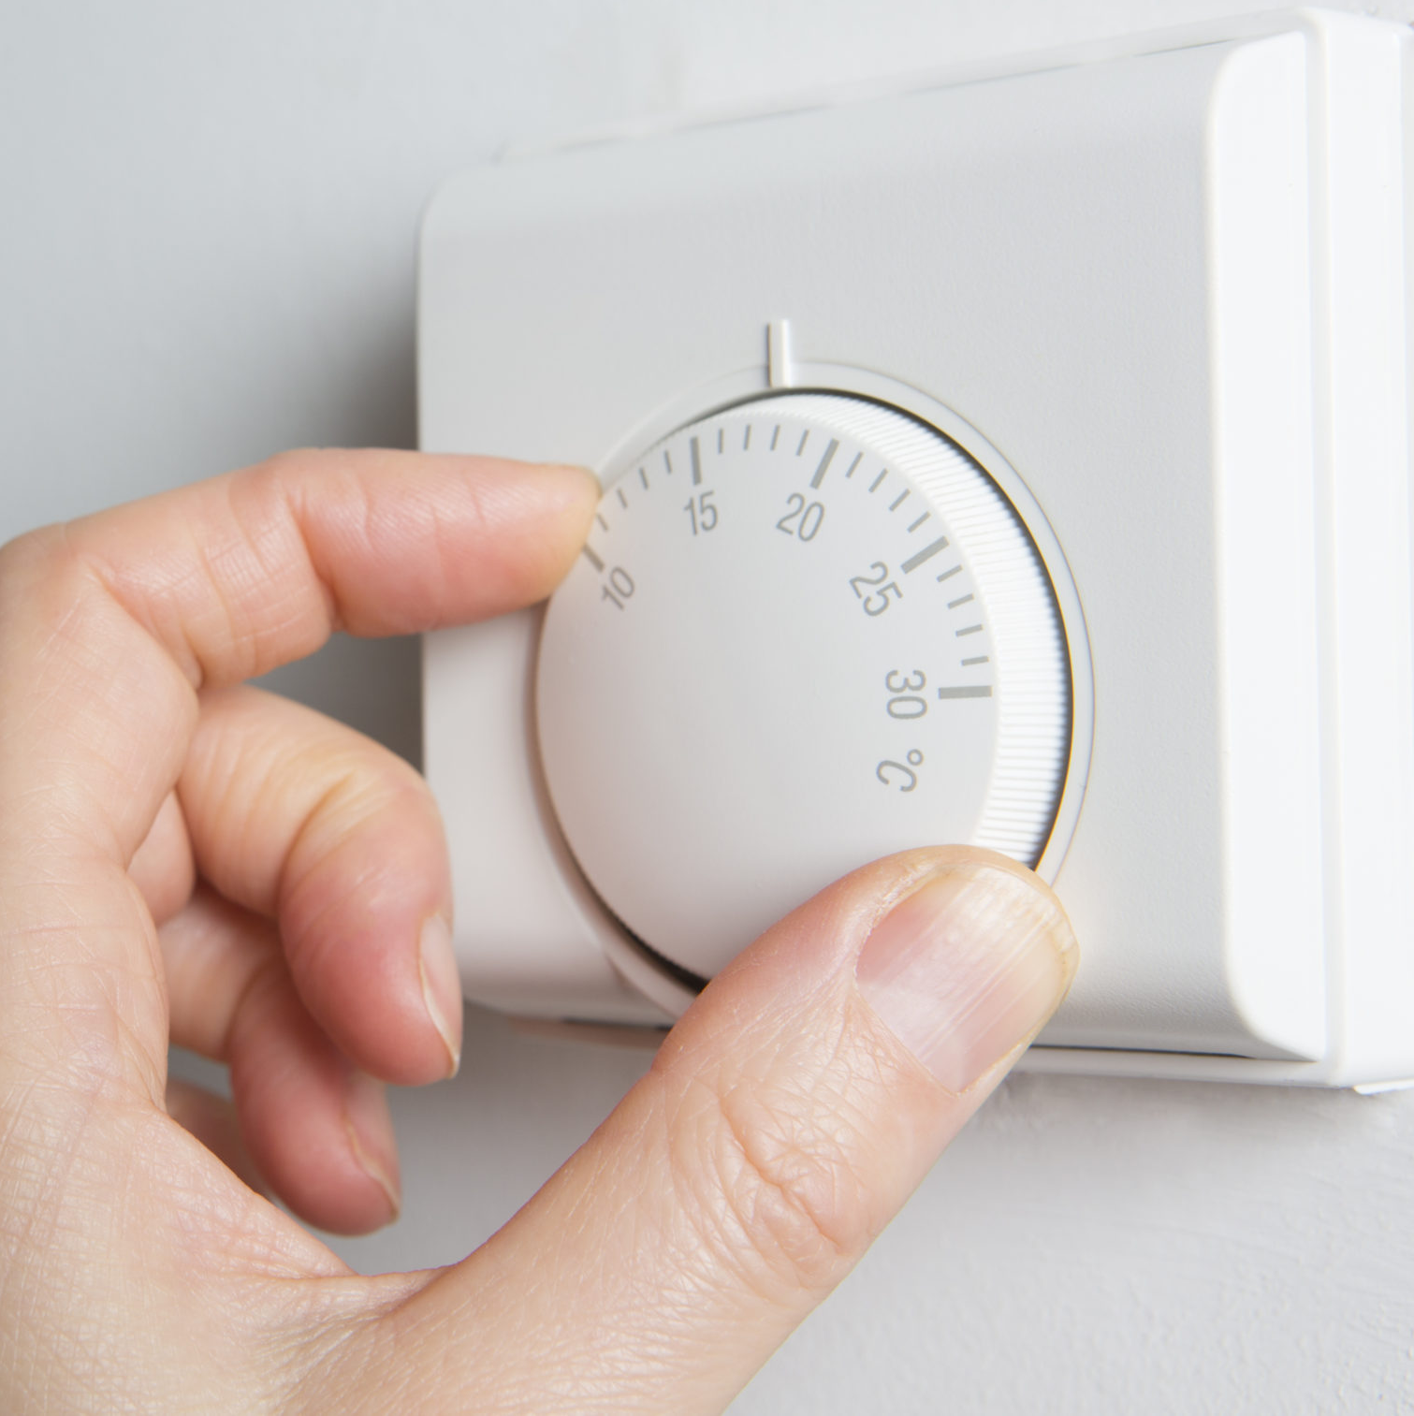
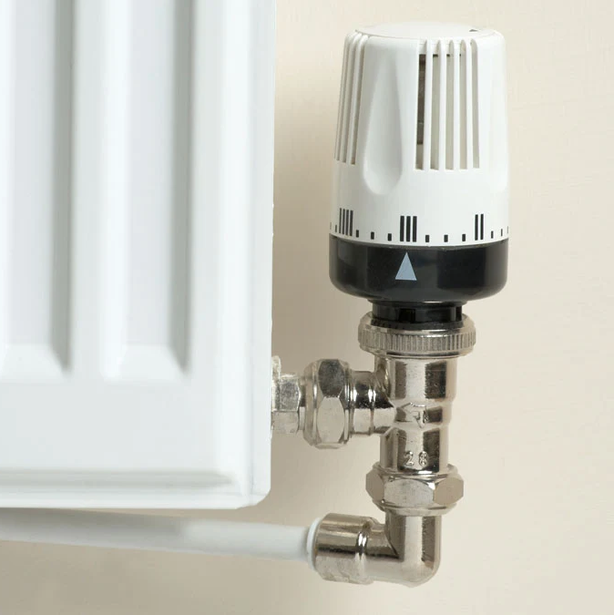
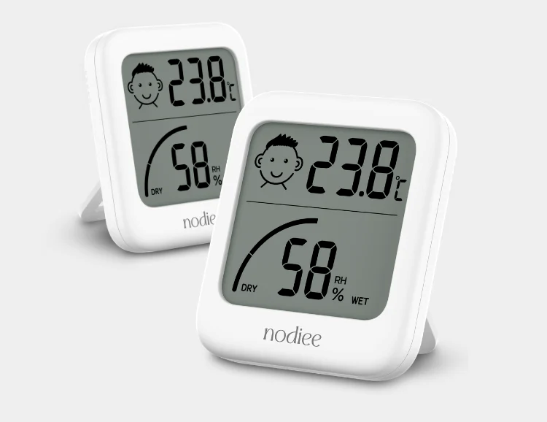
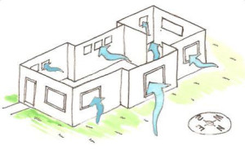

Temperature control, heating and cooling
Lowering the heating temperature by just 1ºC can save 8% on energy costs.
In premises with well-controlled systems, heating consumption is typically 15-30% lower.
Getting the best efficiency and lowest costs is all about focusing on ensuring you have the right amount of heat at precisely the right times when you need it.
Set up timers, use controls including thermostats (and thermometers to monitor).
Zone areas if you can, only heat the spaces you need. Turn down thermostats in rooms you are not using.
Everyone has different needs, but The Carbon Trust suggested temperatures of:
  Offices – 21-23ºC
  Restaurants/cafes – 22-24ºC
  Banks, post offices, retail – 19-21ºC
  Areas of light work – 16-19ºC
Communication with staff is key. Help them to know and display guidance on how to control any heating and how to ensure maximum efficiency.
1/3 of heating costs can be saved by preventing cold air from entering a building. The following steps won’t cost you a penny:
Make sure staff are aware of the cost of wasted heat.
Seal up any draughts, unused doors and flues.
Doors are not propped open for convenience. Keep doors closed to any heated rooms.
Staff are encouraged to turn the thermostat down before opening doors or windows

Slide 11
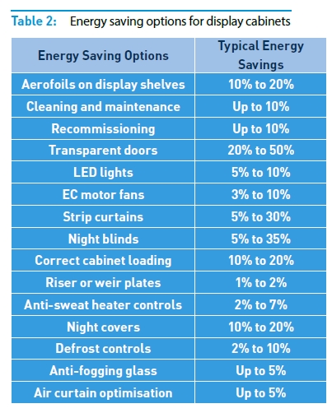
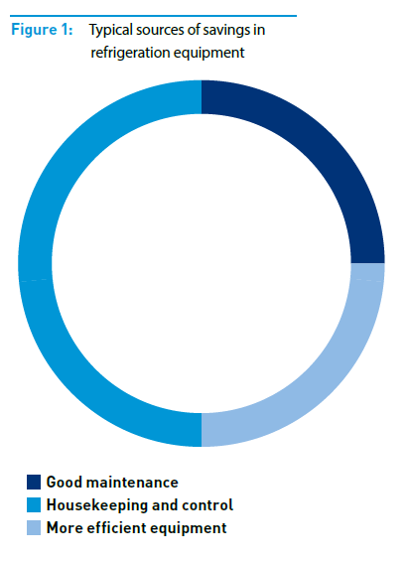
Refrigeration
A difficult one. Three areas of savings; maintenance, control or equipment upgrade.
Sometimes it is a business decision if you need the refrigeration or not.
  Do the sales from refrigerated drinks contribute enough for its energy costs?
  Can an open display fridge be changed to one with clear windows? (Open display fridges are very power hungry).
Is there any overheating in the summer
with a number of refrigeration units
constantly adding to that heat?
Some good considerations are:
  LED lights in display fridges
  Night blinds/covers
  Upgrading units (downsize? add doors?)

Slide 12
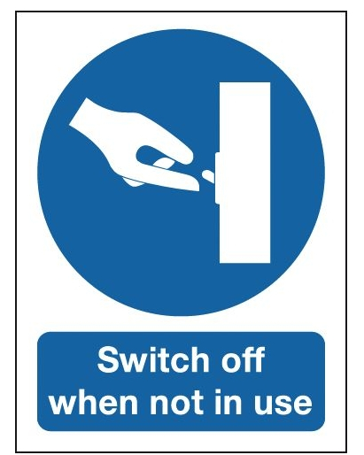
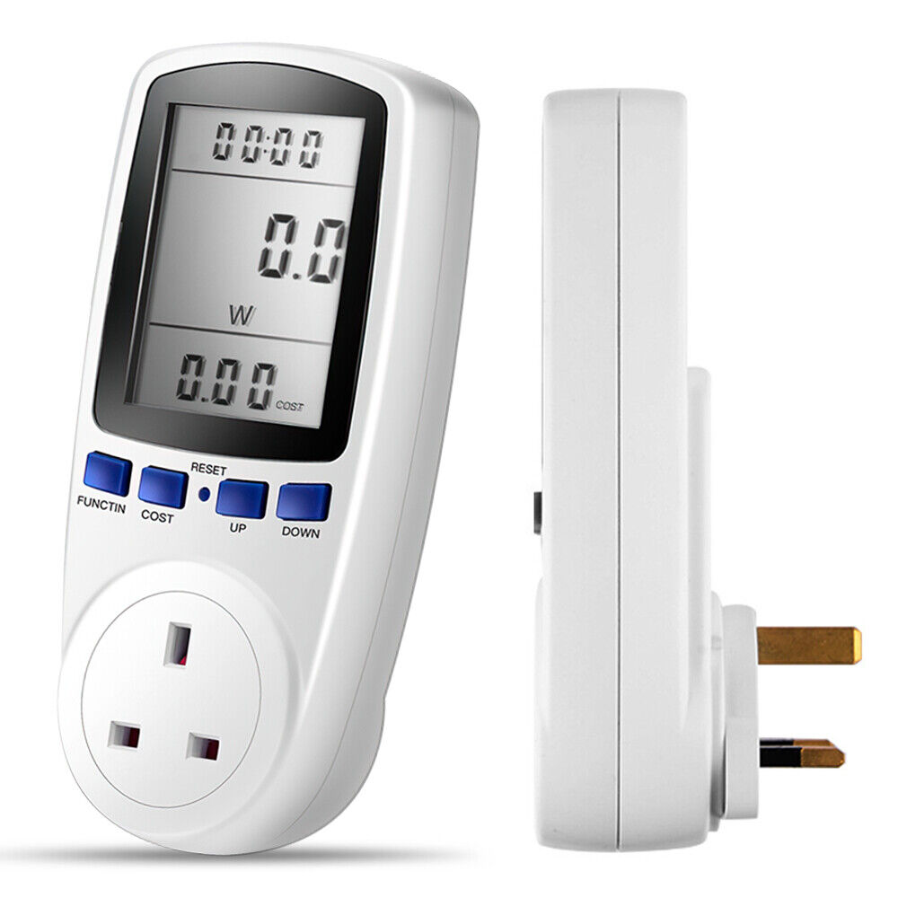
Management and communication
Over heating by just 1ºC can cost and additional 8% on energy costs.
There can often be some good quick wins which require little to no cost and effort.
The Carbon Trust suggests spending 1-2% of your energy spend on ensuring effective control could lead to these 5-10% savings.
Adding monitoring and effective heating controls could potentially lead to 15-30% savings.
Some points already mentioned in Temperature Control slide. Other things you could consider include:
  Checking heating controls and times match what you want them to be.
  Using a room thermometer to monitor heating and ensuring no overheating.
  Engagement and communication with staff or customers on heating or lighting controls.
  Ensuring refrigeration temperatures are correct for food type, and are switch off if not really needed (eg drinks fridges overnight).
The Heat Project has an energy plug meter if wanted to see how much energy any particular appliance was using and costing you.

Slide 13

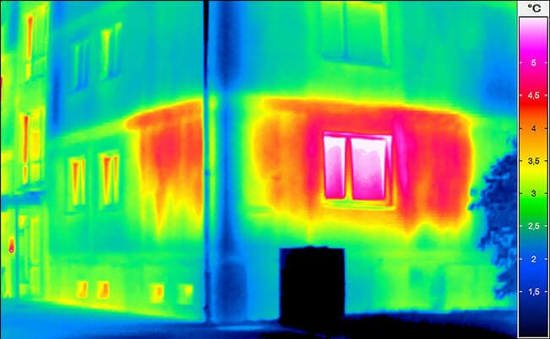
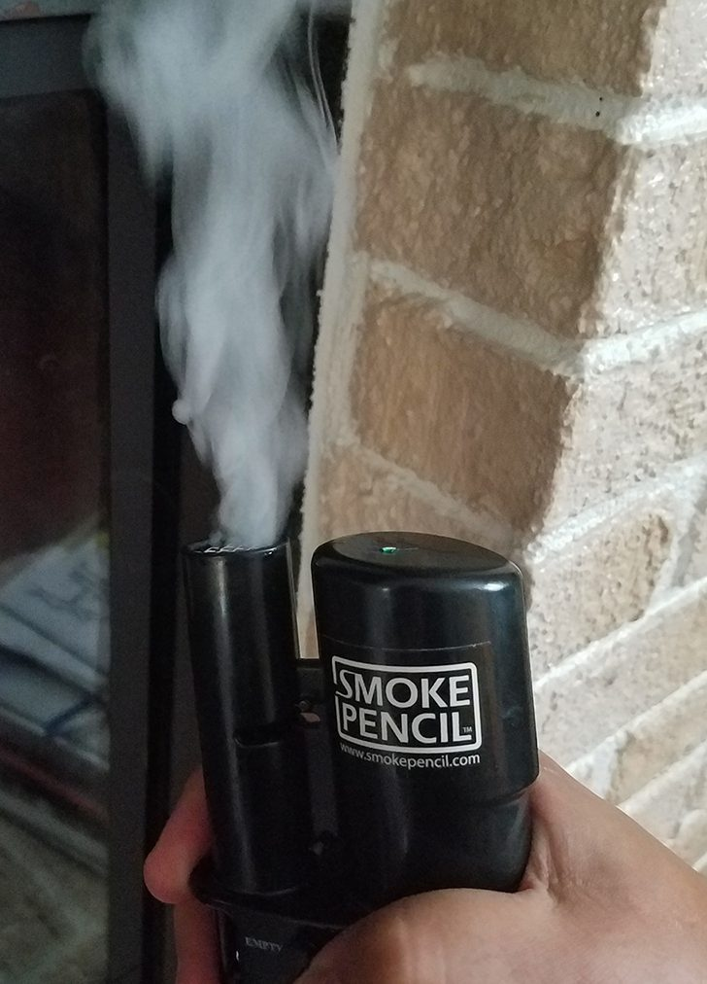

You can get a 1 to 1 visit from us to help with the specifics of YOUR business
Every individual case is different.
Free energy advice survey with The Heat Project!
Extras:
  Sustainability and/or carbon footprinting advice
  Draught proofing survey
  Thermal imaging (low resolution tool) in winter or overheating in summer
  Energy plug monitoring with a plug meter
  Solar panel modelling, cost and savings
  Electric heating to heat pump upgrade, cost and savings
Funding advice
The Heat Project can help with any SME or household in Perth and Kinross, all free and not just a one off, but continual support as needed.

Slide 14
Summary/key takeaways
Summarising some of the easy wins that have low risk and zero to low cost:
  LED lights
  Draught proofing
  Quick win insulation
  Heating controls
  1:1 support freely available
  Funding support for upgrades (including controls)
    75% grants, 0% loans from Business Energy Scotland
    50% grants from PKC (potentially able to combine)

